Slide 1
Try your adventure

Slide 2
Introduction
This project is based on a simple text based adventure game
Here you are given with the two choices
You have to make the correct decision in order to win the game using the key words given in the system

Slide 3
What is a Text-Based Adventure Game
A Text-Based Adventure Game is a type of game in which a player has to make choices in every step of the game.
Based on these choices, the storyline changes, and at last, we get to know that whether the player wins or loses the game.
So, In this article also, we have a storyline for our game which we have discussed below.

Slide 4
Python statements and library functions used in this code are,
Input commands
If statement
Elif statement
Else statements

Slide 5
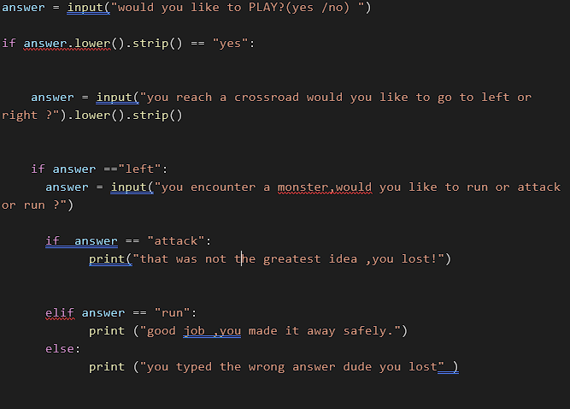

Slide 6
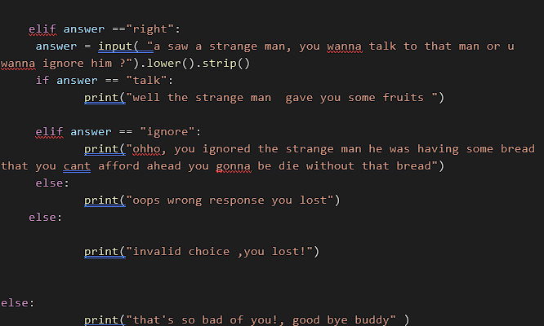

Slide 7
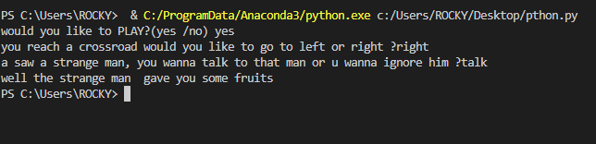
Output

